Slide 1
HOW TO DESIGN SUSTAINABLE BUILDING WITH EXAMPLE CASE STUDY
TOURIST INFORMATION CENTRE, ZION NATIONAL PARK, U.S.A

Slide 2
FOUR COMPONENTS CRITICAL TO THE CREATION OF A SUSTAINABLE BUILDING
The occupant
The design team
The building as a system
The design process

Slide 3
Four Components Critical to the Creation of a Sustainable Building
The occupant
The design team
The building as a system
The design process

Slide 4
FUNDAMENTALS OF THERMAL COMFORT

Slide 5
“Thermal Comfort:
That condition of mind which expresses satisfaction with the thermal environment.”

Slide 6
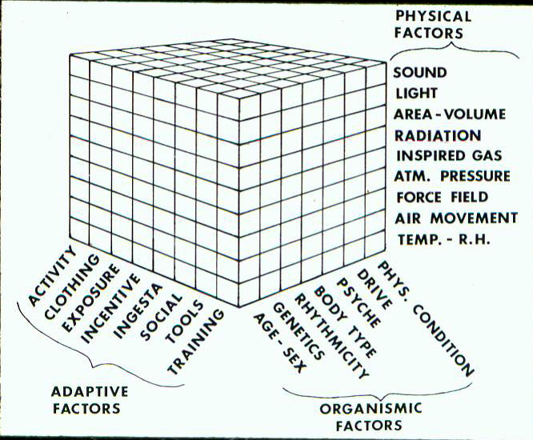
VARIABLES AFFECTING COMFORT

Slide 7
PRINCIPLES OF HEAT TRANSFER
Humans transfer sensible heat by conduction, convection and radiation.
Humans transfer latent heat by evaporation from the skin (evaporation of perspiration) and through respiration.

Slide 8
METABOLISM
Different for sedentary and strenuous work.
Metabolic capacity of trained athlete can reach 20 times their sedentary rate.
More typical maximum is 12 times sedentary for age 20 and 7 times sedentary for age 70.

Slide 9
THERMAL EQUILIBRIUM
Is achieved when the metabolic rate equals rate of heat loss less work.*
* Thermal equilibrium does not necessarily mean comfort.

Slide 10
PHYSIOLOGICAL RESPONSES
Sweating = Increased Evaporation (little benefit from dripping sweat)
Note: If heat production is greater than heat loss, first mechanism is vasodilatation which can double or triple heat loss. Conditioned athletes sweat a higher proportion of water to oil.
Shivering = Increases Metabolism

Slide 11
THERMAL NEUTRALITY
That condition where no physiological response is needed other than vasomotion to maintain a normal body temperature.
Normally achieved between T_{o} = 73ºF to 81ºF for clothed sendentary and 84ºF to 88ºF unclothed.

Slide 12
DISCOMFORT
Localized discomfort will overshadow comfort even under conditions of thermal neutrality.
Causes of localized discomfort include asymmetric radiation, drafts, contact with cold or hot floors, vertical temperature differences.

Slide 13
DISCOMFORT CONTINUED
Drafts have a disproportionate effect on comfort based on heat transfer.
Dissatisfaction with the environment grows exponentially as air turbulence increases.

Slide 14
Purpose of studying thermals:
“...to specify the combinations of indoor space environment and personal factors that will produce thermal environmental conditions acceptable to 80% or more occupants within the space.”

Slide 15
FOUR COMPONENTS CRITICAL TO THE CREATION OF A SUSTAINABLE BUILDING
The occupant
The design team
The building as a system
The design process

Slide 16
THE DESIGN TEAM
“This requires cooperation . . . among equal partners of architects, engineers, contractors, building users and others.”

Slide 17
AT A MINIMUM THE TEAM MUST INCLUDE
Building Owner
Project Manager
Building Designers
  HVAC&R Engineer
  Structural Engineer
  Architect
Builder/Contractor
Equipment Suppliers
Building operator

Slide 18
ADDITIONAL DESIGN TEAM MEMBERS
Lighting Designer
Interior Architect
Landscape Architect
Lifts and Controls Engineer
Energy Utilities Provider
Code Official
Financial Institution
Insurer

Slide 19
WHAT WILL THE FUTURE BRING?
“It is probable that within a very few years companies of designers, manufacturers and contractors who operate as they did in the latter part of the 20th century will be looked upon as a living museum”
Rooley
“During your professional lifetime you may well serve on a design team of members you will never meet on a project you will never see in a country you never visit.”
Hayter

Slide 20
FOUR COMPONENTS CRITICAL TO THE CREATION OF A SUSTAINABLE BUILDING
The occupant
The design team
The building as a system
The design process

Slide 21
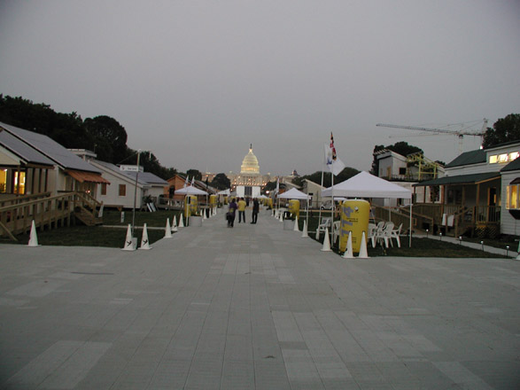
THE BUILDING AS A SYSTEM
www.solardecathlon.org

Slide 22
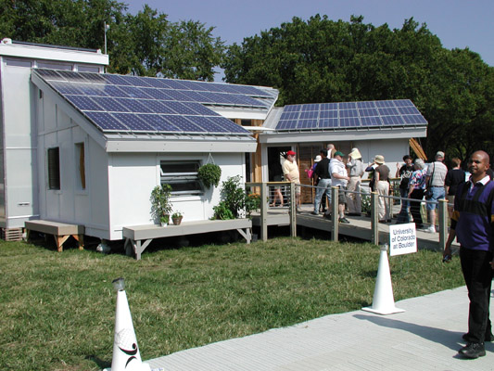
THE BUILDING AS A SYSTEM

Slide 23
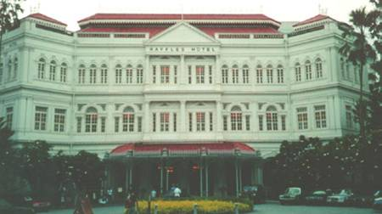
THE BUILDING AS A SYSTEM

Slide 24
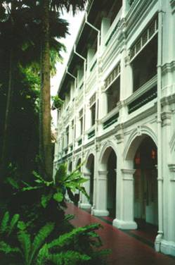
THE BUILDING AS A SYSTEM

Slide 25
FOUR COMPONENTS CRITICAL TO THE CREATION OF A SUSTAINABLE BUILDING
The occupant
The design team
The building as a system
The design process

Slide 26
THE DESIGN PROCESS
Critical Initial Steps
Agree to a vision for the performance goals
Form an all-inclusive project team
Agree to the process for making design, construction and occupancy decisions.
Hold design charrette.

Slide 27
“The design charrette is the mechanism that starts the communication process among the project team members, building users and project management.” Sheila Hayter

Slide 28
THE DESIGN PROCESS
Pre-design: Evaluate building functions, size, site & local conditions.
Base-case Building Model: Meet prescriptive energy and building functional requirements
Parametric Analysis: Develop sensitivity analysis

Slide 29
THE DESIGN PROCESS
Create Design Options: Consider building geometry, envelope, systems, energy sources, etc.
Simulate Options: Investigate variants of base-case building using options from previous step including effect of interactions.

Slide 30
THE DESIGN PROCESS
Conceptual Design: Integrate energy features into architectural design. Refine based on simulation. Optimize envelope for energy use.
Design Development: Simulate options for HVAC system & controls. Investigate envelope & system trade-offs.

Slide 31
THE DESIGN PROCESS
Bid Documents & Specifications: Assure that compromises are avoided such as thermal bridging, poor equipment efficiency, code violations. Simulate any modifications.
Construction: Simulate change orders. Hold regular design reviews. Maintain communications.

Slide 32
THE DESIGN PROCESS
Commissioning & Post Occupancy Evaluation: Test subsystems including controls. Simulate any building-use changes from original intent to make needed system adjustments. Educate building owner/operator. Provide sufficient instructions for future users.

Slide 33
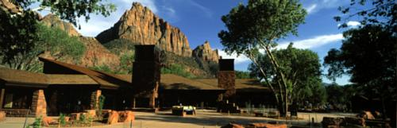
EXAMPLE CASE STUDY:
ZION NATIONAL PARK VISITOR CENTER
www.highperformancebuildings.gov/zion/

Slide 34
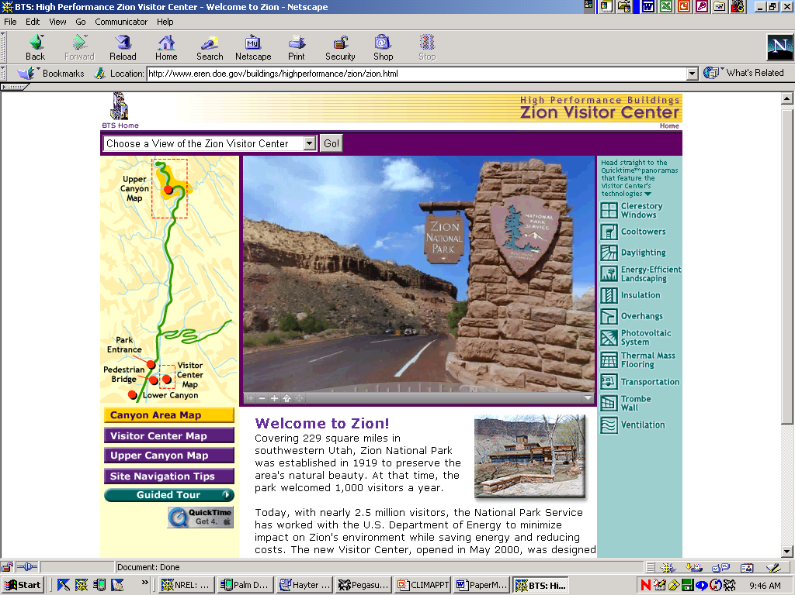

Slide 35
ZION NATIONAL PARK VISITOR CENTER – THE CONDITIONS
Hot & Dry Climate (100ºF daytime high)
Night temperatures in wider areas of canyon will drop to 59ºF
Slot canyon (2000’ deep)
Canyon provides significant shading
Wet canyon walls provide evaporative cooling

Slide 36
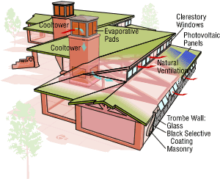
ZION NATIONAL PARK VISITOR CENTER – DESIGN FEATURES
Goal – Use 70% less energy than ASHRAE Standard 90.

Slide 37
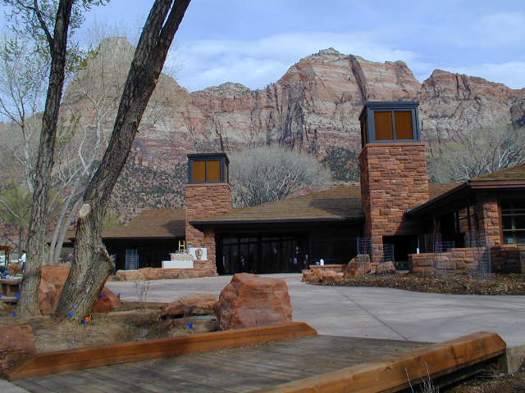
ZION NATIONAL PARK VISITOR CENTER – DOWNDRAFT COOL TOWERS

Slide 38
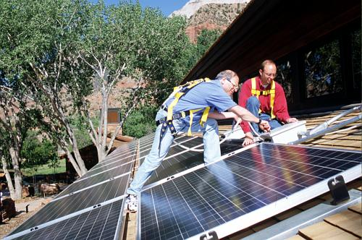
ZION NATIONAL PARK VISITOR CENTER – 7.2-KW PV SYSTEM
PV provides 30% of daytime electrical load & 100% of basic functional requirements.

Slide 39
ZION NATIONAL PARK VISITOR CENTER - CONSTRUCTION
Construction costs 30% less than planned for conventional building.

Slide 40
ZION NATIONAL PARK VISITOR CENTER – LESSONS LEARNED
Cooltowers with natural ventilation work best when serving open spaces. Offices with closed doors tend to overheat.
White-washed ceiling less reflective than original design.
No task lighting in original plan. Added later.

Slide 41
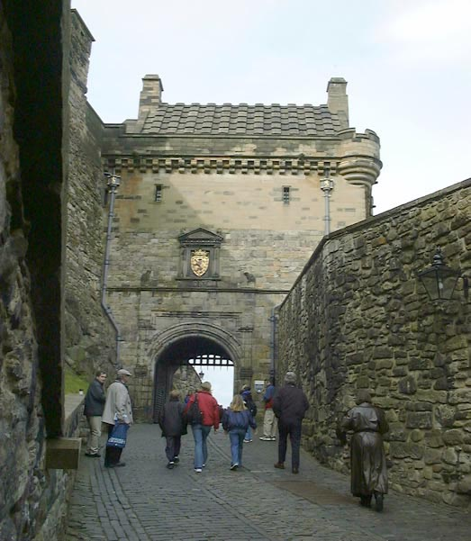
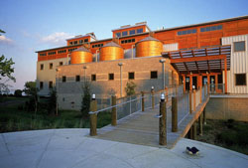
CONCLUSION
So what is your vision for a sustainable future?
or

Slide 42
CONCLUSION
“Vision without action is merely a dream and action without vision just passes the time, but vision with action can change the world.”
Joel Barker

